Slide 1


Green Pace
Security Policy Presentation
Developer: Oscar Rosa
Notes:
Hello, my name is Oscar Rosa, and in this presentation, I’ll walk you through the Green Pace Security Policy. This policy was developed to formalize the secure coding practices already in use and ensure they remain consistent as our team grows. It’s built around core security principles and integrates directly into our development workflow. Let’s begin by looking at how this policy supports a defense-in-depth strategy.

Slide 2

OVERVIEW: DEFENSE IN DEPTH
Establishes a consistent and enforceable secure development policy
Codifies proven practices using ten core security principles
Reduces risk by applying a layered defense-in-depth strategy
Supports continuous improvement through integration with DevSecOps
Notes:
This policy defines how we secure our systems by applying layered protections at every stage of development. It translates proven practices into standardized guidelines built around ten core security principles. By integrating automation, testing, and validation into the DevSecOps process, we reduce the chances of vulnerabilities reaching production. This layered strategy ensures security remains proactive and scalable as our development efforts grow.

Slide 3
THREATS MATRIX
Likely STD-009-CPP STD-006-CPP | Priority STD-002-CPP STD-003-CPP STD-004-CPP STD-005-CPP STD-007-CPP STD-008-CPP STD-010-CPP
Low priority STD-001-CPP STD-009-CPP STD-006-CPP | Unlikely STD-001-CPP STD-006-CPP
Notes:
This matrix ranks our ten coding standards by severity, likelihood, and cost to fix. Level 1 priorities—like STD-002 through STD-005, STD-007, STD-008, and STD-010—cover common, high-risk issues such as input validation flaws, memory mismanagement, and integer overflows. These are likely to occur and cost-effective to address, making them key targets for early testing. Level 2 standards—STD-001, STD-006, and STD-009—pose lower risk or occur less frequently but still enhance overall code quality, like improving enum use or adding static assertions. This matrix helps us focus security efforts on the most impactful vulnerabilities to reduce risk before deployment.

Slide 4
10 PRINCIPLES
Validate Input Data – STD-002-CPP, STD-003-CPP, STD-004-CPP, STD-005-CPP, STD-008-CPP, STD-009-CPP, STD-010-CPP
Heed Compiler Warnings - STD-002-CPP, STD-006-CPP, STD-008-CPP
Architect and Design of Security policies - STD-010-CPP
Keep It Simple - STD-001-CPP, STD-003-CPP, STD-005-CPP, STD-008-CPP, STD-009-CPP
Default Deny - STD-004-CPP
Adhere to the Principle of Least Privilege – General Policy
Sanitize Data Sent to Other Systems - STD-004-CPP
Practice Defense in Depth - STD-001-CPP, STD-002-CPP, STD-004-CPP, STD-005-CPP, STD-007-CPP, STD-009-CPP
Use Effective Quality Assurance Techniques - STD-003-CPP, STD-005-CPP, STD-007-CPP, STD-008-CPP, STD-009-CPP
Adopt a Secure Coding Standard - ALL
Notes:
These ten principles are the foundation of Green Pace’s security approach. Each one shapes how we write secure code—like validating all input, enforcing memory safety, and reducing system complexity. Every principle connects to specific coding standards to ensure consistent enforcement. For instance, input validation links to standards on safe casting and buffer handling. Some principles, like Least Privilege, guide design decisions even if not tied to a single rule. Others, like following secure coding standards, apply to all development phases. This alignment keeps our policy clear, consistent, and scalable across teams.

Slide 5
CODING STANDARDS
STD-001-CPP - Declare Objects with Appropriate Storage Duration
STD-002-CPP - Ensure that operations on signed integers do not result in overflow
STD-003-CPP - Range Check Element Access
STD-004-CPP - Avoid Using Data from an Untrusted Source Without Validation
STD-005-CPP - Do Not Access Freed Memory
STD-006-CPP - Use Static Assertions for Constant Expression Checks
STD-007-CPP - Do Not Leak Resources When Handling Exceptions
STD-008-CPP - Do Not Read Uninitialized Memory
STD-009-CPP - Do Not Cast to an Out-of-Range Enumeration Value
STD-010-CPP - Only Free Memory Allocated Dynamically
Notes:
This slide outlines the ten coding standards that protect Green Pace systems from common software vulnerabilities. Each standard targets a specific issue—like memory corruption, logic flaws, or unsafe input—and is prioritized by severity, likelihood, and cost to fix. Critical standards, such as STD-002 and STD-004, address risks like integer overflow and unvalidated input. Others, like STD-007 and STD-010, focus on proper memory and resource management. These standards are designed to be enforceable through static analysis and unit testing, making them scalable and consistent across teams. Overall, they support a secure-by-design approach that aligns with defense-in-depth strategies.

Slide 6
ENCRYPTION POLICIES
Encryption at Rest: Sensitive data such as credentials and configuration files must be stored securely. Encryption algorithms like AES-256 are required to ensure that, even if storage is compromised, the data remains unusable without decryption keys. Delayed-access encryption methods are acceptable for infrequently accessed data.
Encryption in Transit: All network communication must be encrypted using secure protocols such as TLS 1.2 or higher. Systems must verify the identity of recipients, and transmitted data should be obfuscated to prevent interception or tampering during transmission.
Encryption in Use: Data actively being processed should be handled in memory with minimal exposure. Techniques like memory obfuscation or trusted execution environments (e.g., Intel SGX) should be used when practical. Performance considerations must not compromise encryption effectiveness.
Notes:
This encryption policy protects data at all stages—when it's stored, sent, and being used. For stored data, we use strong encryption like AES-256 to secure things like passwords, logs, and backups. For data that’s rarely accessed, we choose stronger encryption even if it's slower. When data is being sent, we use secure methods like TLS 1.2 or higher, along with identity checks to keep it safe from tampering. While in use, we protect sensitive information in memory using techniques like obfuscation or secure environments to limit exposure. These steps help keep our systems secure and meet compliance requirements.

Slide 7
TRIPLE-A POLICIES
Authentication: All systems must verify user identities using secure methods such as multifactor authentication (MFA), strong passwords, or biometric systems.
Authorization: Role-based access control (RBAC) must be implemented to ensure users only access resources necessary for their role.
Accounting: All user and system activity must be logged and monitored to ensure traceability, support incident response, and maintain compliance.
Notes:
The Triple-A framework—Authentication, Authorization, and Accounting—is essential for protecting access to Green Pace’s systems and data. Authentication ensures only verified users gain access through secure methods like MFA or biometrics. Authorization enforces role-based access, limiting users to only the resources necessary for their duties. Accounting provides system-wide logging and monitoring of user activity, aiding in audit readiness and incident response. Together, these policies establish strong access governance and align with our defense-in-depth approach.

Slide 8
Unit Testing
Unit testing ensures each component behaves as expected.
Focus: Testing vector operations using C++ and Google Test framework, that demonstrates both positive and negative test cases.
Test chosen for this presentation:
Smart pointer initialization
Out-of-range access
Negative index handling
Vector size increase with push_back
Notes:
In this section, we’ll go over four specific unit tests selected to showcase effective verification of vector operations in C++ using the Google Test framework. These tests were chosen because they cover both safe initialization and boundary error handling, which are critical in secure development. We’ll start with confirming the smart pointer is correctly initialized. Then we’ll move into two negative test cases that ensure the program correctly throws exceptions when accessing invalid indices. Lastly, we’ll look at a positive test confirming that push_back() correctly increases vector size. Each test demonstrates good testing practices and highlights areas where defensive coding can prevent runtime issues or crashes. Let’s begin with the first test.

Slide 9
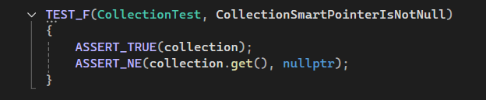
Unit Testing
CollectionSmartPointerIsNotNull
Notes:
This unit test checks that the collection smart pointer properly initialized. It confirms:
The smart pointer is not null with (ASSERT_TRUE(collection)).
And that the raw pointer it holds is also valid with (ASSERT_NE(collection.get(), nullptr)).
This test passed, meaning memory was successfully allocated during setup. It ensures all other tests using the collection can run safely without crashing. To take it a step further, we could simulate low-memory conditions or test exception handling during allocation. Using Google Test helps automate this validation and ensures safe memory use, which is important for secure, stable applications.

Slide 10
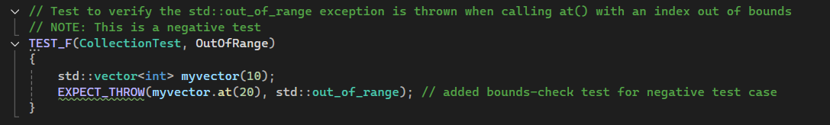
Unit Testing
OutOfRange
Notes:
This test ensures the program correctly throws an std::out_of_range exception when accessing an invalid index using the .at() method on a vector. It checks that the system handles errors safely instead of crashing. This is a negative test, meaning it verifies the system fails in a controlled way. It’s important for preventing unexpected behavior in user-facing or critical applications. To improve, we could:
Test edge cases like accessing the last valid index.
Apply similar tests to other containers.
Or use the .at() method in production code to enable bounds checking.
Overall, this shows how unit tests help catch errors early using EXPECT_THROW in the GTest framework.

Slide 11
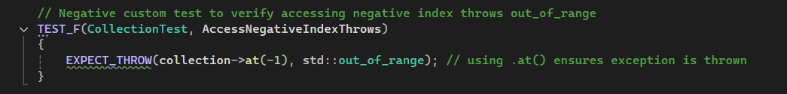
Unit Testing
AccessNegativeIndexThrows
Notes:
In this test, we’re verifying that the vector throws an out_of_range exception when we try to access a negative index using the .at() method. This is a form of negative testing—meaning we’re intentionally triggering an error to confirm the system responds safely. The key here is that .at() includes built-in bounds checking, so if the index is invalid—like in this case—it will throw an exception instead of silently failing or causing unexpected behavior. This helps prevent potential crashes or security issues, especially when handling user input. We could take this a step further by testing additional invalid scenarios, like accessing indices beyond the vector size or operating on an empty vector.

Slide 12
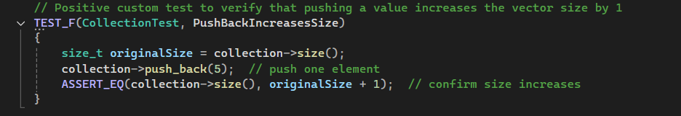
Unit Testing
PushBackIncreasesSize
Notes:
This test confirms that when we use push_back() to insert an element into the vector, the size increases by exactly one. It starts by recording the original size, adds a single value, then checks that the new size is one more than before. This verifies the core functionality of dynamic resizing in a vector and ensures data is being stored as expected. To enhance this, we could test multiple insertions or measure performance impact under heavier loads. Including this in automated test suites ensures consistent behavior after each code change.

Slide 13

AUTOMATION SUMMARY
Notes:
Security automation is integrated across the DevSecOps pipeline. At the commit and build stages, static code analysis checks for policy violations and insecure patterns. During compilation, secure compiler flags detect unsafe behavior and misconfigurations. In the testing stage, automated unit and integration tests with security assertions validate functionality and catch regressions. By placing tools at every stage—commit, build, compile, and test—we ensure consistent enforcement of security standards and early detection of vulnerabilities.

Slide 14
TOOLS
DevSecOps Pipeline and Tools:
Development – Cppcheck and Clang-Tidy catch errors early in the coding phase.
Build – Compiler flags (-Wall, -Werror, -fsanitize) enforce secure builds.
Test – Visual Studio Test Framework automates unit/integration tests.
Release – Secure configurations are applied during deployment.
Deploy and Operate – Runtime monitoring tools track anomalies post-release.
Tool Summary by Design Stage:
Plan – Security policies defined and reviewed.
Develop – Static analysis tools (Cppcheck, Clang-Tidy) used on commit.
Build – Compiler flags applied; secure builds enforced.
Test – Automated tests run; validation of secure code.
Release – Deployment scripts apply secure configurations.
Deploy – Secure images deployed; container security tools used.
Operate – Runtime logging, monitoring, and alerts active.
Monitor – Feedback loops ensure continuous improvement.
Notes:
At Green Pace, we embed security tools across each stage of the DevSecOps pipeline. In the Plan phase, we define security policies that guide development. During Develop, we run static analysis tools like Cppcheck and Clang-Tidy through version control to catch logic errors and memory issues early. In the Build phase, we enforce compiler flags like -Wall, -Werror, and use sanitizers to detect unsafe patterns. At Test, automated unit and integration tests using Visual Studio validate functionality and security. During Release and Deploy, we scan containers and apply hardened configurations to ensure integrity. Finally, in Operate and Monitor, we use runtime monitoring and alerts to detect anomalies and feed findings back into the cycle. This toolchain supports a continuous, automated defense-in-depth strategy throughout development.

Slide 15
RISKS AND BENEFITS
Problems:
- Outdated legacy code and delayed vulnerability patches
- Irregular enforcement of secure coding practices
- Insufficient runtime threat visibility
Risks of Inaction:
- Security breaches and data loss
- Escalating costs for future remediation
- Potential legal and reputational fallout
Benefits of Immediate Action:
- Faster vulnerability response and resolution
- Stronger code integrity and operational reliability
- Enhanced compliance and organizational trust
Notes:
Green Pace currently faces risks due to legacy code, inconsistent secure coding practices, and limited runtime visibility. These gaps delay patching and increase the chance of undetected vulnerabilities and potential data breaches. Failing to act could lead to compliance violations, legal penalties, and damage to our reputation. However, addressing these issues now allows us to identify risks early, improve system resilience, and streamline security through automation. This not only protects us from evolving threats but also builds stakeholder trust and ensures regulatory readiness.

Slide 16
RECOMMENDATIONS
Policy Gaps Identified:
No real-time threat intelligence or monitoring integration
Inconsistent application of secure coding standards
Lack of automated enforcement tools in CI/CD pipelines
Limited developer training on modern threat vectors
Recommended Solutions:
Integrate runtime application self-protection (RASP) and SIEM tools
Standardize coding practice through CI-integrated linters and SAST tools
Expand policy automation through pipeline hooks and pre-commit checks
Conduct regular developer training and simulated breach scenarios
Notes:
Green Pace needs stronger enforcement of security practices. While static analysis is in place, we lack runtime tools like SIEM or RASP to catch live threats. Coding standard use is inconsistent, but automated tools like SonarQube and pre-commit hooks can fix this. Finally, developers need better training on modern attack methods to stay ahead. These steps will boost consistency, awareness, and overall security.

Slide 17
CONCLUSIONS
Adopt OWASP Secure Coding Practices to mitigate common vulnerabilities
Enforce continuous integration with security checks using SAST/DAST tools
Standardize secure configuration management (e.g., CIS Benchmarks) Implement secure development lifecycle (SDLC) practices
Adopt minimum privilege and zero-trust standards organization-wide
Notes:
To wrap up, strengthening our security starts with shifting from reactive fixes to proactive practices. By following OWASP’s secure coding guidelines, we equip our team to avoid common vulnerabilities from the start. Integrating tools like SAST and DAST into our CI/CD pipeline ensures issues are caught early, before code reaches production. Standardizing our configurations with CIS Benchmarks helps us avoid misconfigurations across systems. When we embed security into every phase of development, it becomes a consistent part of our workflow, not just an afterthought. And by adopting principles like least privilege and zero trust, we reduce risk at every level, preparing Green Pace for long-term resilience and growth.

Slide 18
REFERENCES
OWASP Foundation. (2022). OWASP Secure Coding Practices – Quick Reference Guide (v2.0.1). https://owasp.org/www-project-secure-coding-practices-quick-reference-guide/
SourceForge. (2025). Cppcheck: A tool for static C/C++ code analysis. https://cppcheck.sourceforge.io/manual.pdf
Microsoft. (2021, August 3). Code analysis for C/C++ overview. https://learn.microsoft.com/en-us/cpp/code-quality/code-analysis-for-c-cpp-overview?view=msvc-170
Red Hat. (n.d.). What is DevSecOps? https://www.redhat.com/en/topics/devops/what-is-devsecops
Intel Corporation. (2022). Intel® Software Guard Extensions (Intel® SGX). https://www.intel.com/content/www/us/en/developer/tools/software-guard-extensions/overview.html
Notes:
This concludes my presentation regarding the security policy for Green Pace. Here are the references used in support of this presentation and thank you for taking the time to view and listen to this presentation.

